Slide 1

HOSPITAL SELECTION
Puspendu Roy

Slide 2
Introduction
Problem
Some Time when a person he / she does not know that place very well so it is very hard for him to find an hospital at the time of emergency some time person may get know the name of the hospital from another person but he does not know about the quality of that particular hospital so in this project we make hospital recommendation system where user will put the detail of the level of quality of hospital and as per his/her quality level we recommended hospital to him .
Now by using Foursquare location this API is used to show the location of those recommended hospital in the world map so by using foursquare API we can explore that particular address to see nearby places where we can take shelter or can take food
So here our main target are those people who have transferable job and who need hospital at the time of emergency . this project will help them to find good hospital as per his quality factor and he also able to find nearby food and rest places

Slide 3
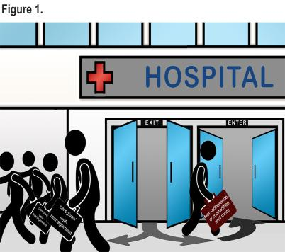
Background
Finding a hospital is different than to find a good hospital some time we are not able to find best hospital at the time of emergency in google map because in google map we can not provide some parameter such as Meets criteria for promoting interoperability of EHRs ,Mortality national comparison footnote, Safety of care national comparison footnote, Readmission national comparison etc so for that we created an project where we can use these feature to recommend a new hospital for our user

Slide 4
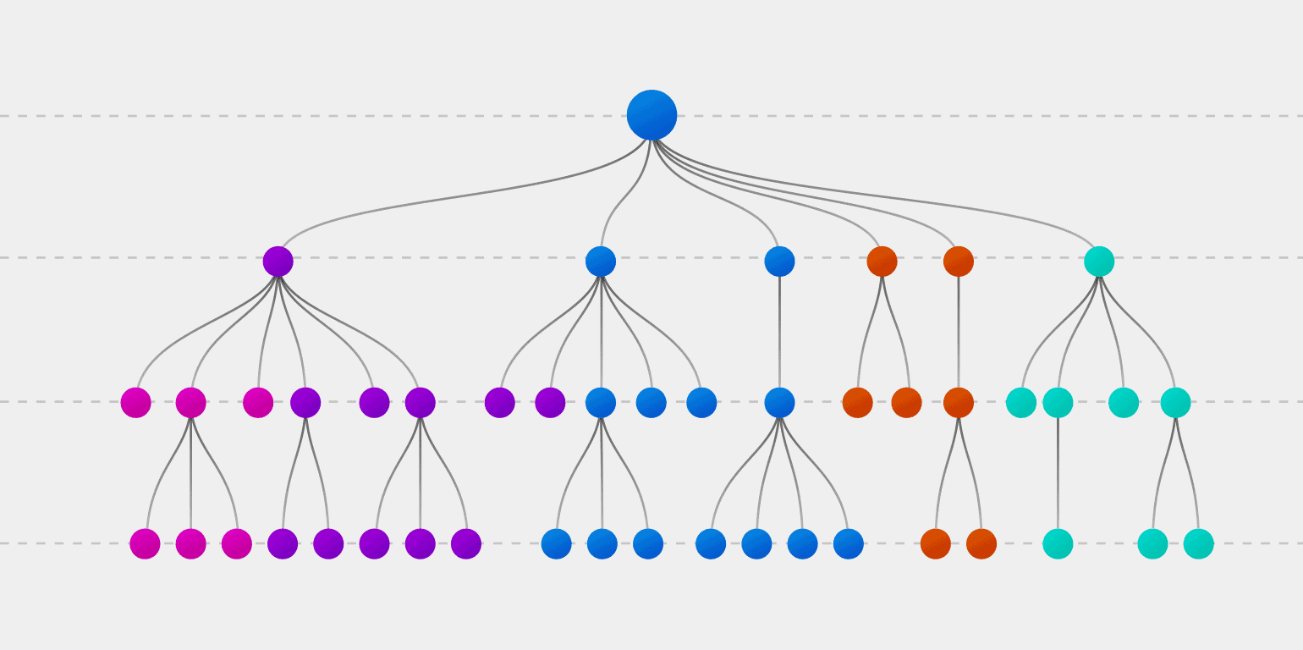
Methodology
To predict the type of hospital I am using the decision tree classifier in decision tree each internal node corresponding to a test each branch correspond to a result of a test each node assign a classification
So to apply this first chose an attribute from your data set which is are following for case
'Emergency Services''Hospital overall rating footnote''Mortality national comparison footnote''Safety of care national comparison footnote''Readmission national comparison footnote''Patient experience national comparison footnote''Effectiveness of care national comparison footnoten.1''Timeliness of care national comparison footnote''Efficient use of medical imaging national comparison footnote'
Calculate the significance of a attribute in splitting the data
Split the data and then based on the value of the best attribute chose that feature to predict the model

Slide 5
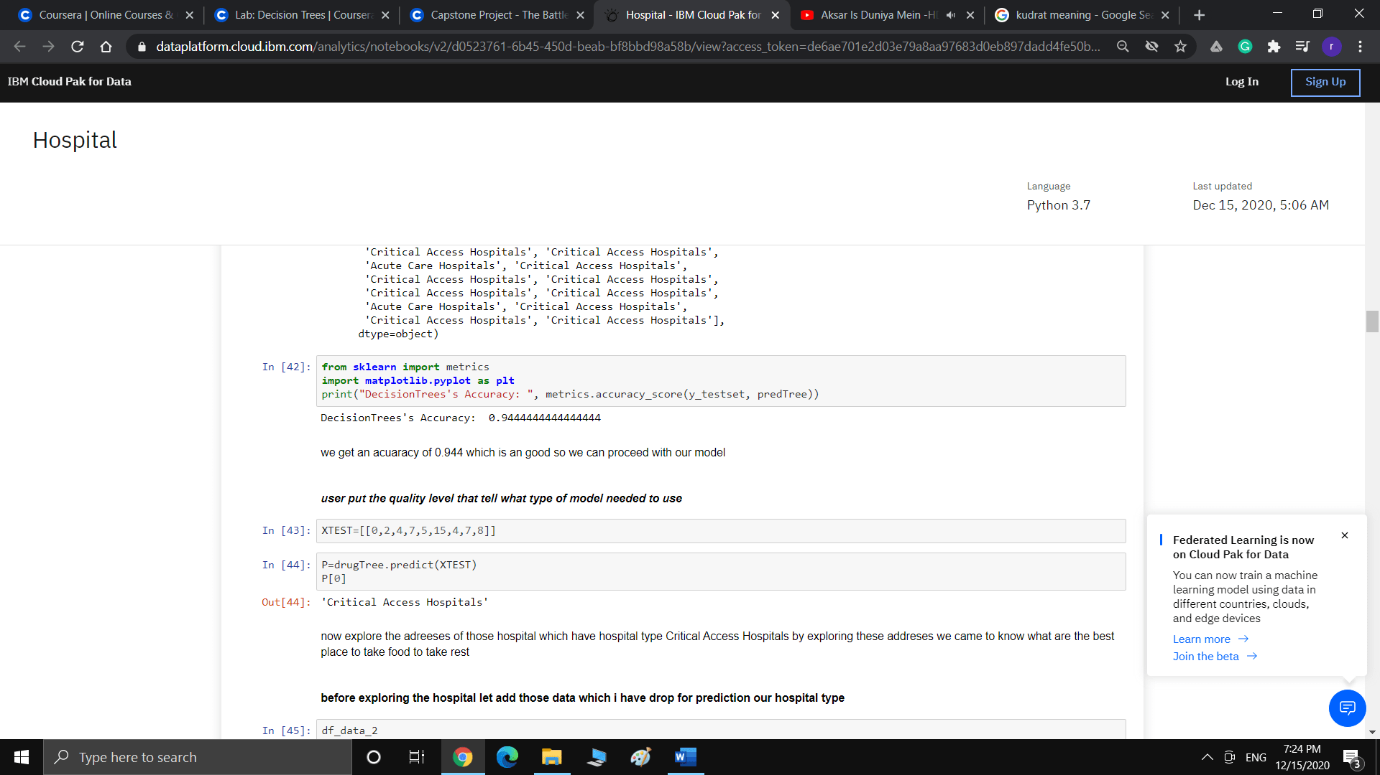
Result
Predict the value based on the user input of quality factor

Slide 6
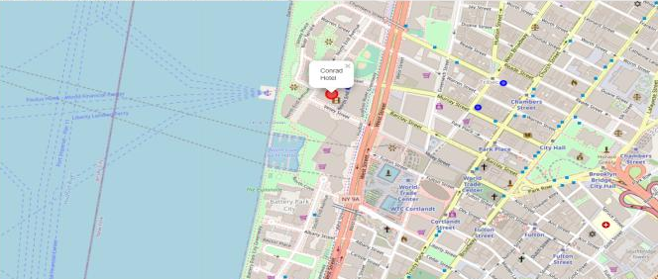
Nearby Places in Hospitals
Nearby place in hospital to take rest

Slide 7
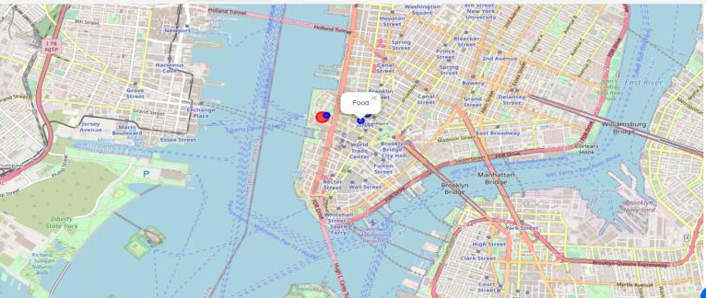
Nearby place in hospital to take food

Slide 8

Discussion
In this project we explore the data of hospital set where different rating according to national standard is given so we chose it as an feature to predict the type of hospital in as per those hospital and we get an accuracy of 0.97 for our selected variable which is an strong indication to used this model to predict our hospital type after predicting the type of hospital we have to get the nearby places in hospital which we get in new York odiously we will get in new work as our hospital is also in the new work so there we find rest places and foodies .This Project can be extended to a AI level so that once I select the hospital the hospital stored my data and when I reached there then a display board should display my appointed doctor and his cabin number and the time when he will be free

Slide 9
Conclusion
In this project we explore the data where we find the hospital type as per user and we explore that area first we get an accuracy of 0.97 then we proceed with our data set and find the hospital type here in this case we find a hospital type of critical type hospital and then analysed its surrounding place to get know the best place to halt and take food .

